Slide 1
Clickstream Analysis using Artificial Neural Network
Submitter Info
Nithya Vasudevan
B.Tech, Information Technology
Rajalakshmi Institute of Technology
Tata Consultancy Services Limited
2.5 Years
Python, Machine Learning, Deep Learning, MicroStrategy (BI Tool)
Thenmozhi Vasudevan
Master of Computer Applications
Anna University
Aspire Systems
5.5 Years
AngularJS, NodeJS, .NET - C#, SQL Server

Slide 2
Problem Statement and Objective
Problem Statement
To define a business solution for identifying and integrating user actions with the certainty of placing the order
Objective
Use the valuable customer information that was captured on web logs of user activities to get an idea of how successful the site is at producing sales
Key differentiating sequence of clicks between people ordered and not ordered
Identify click-stream that lead customers to never checkout the products
Data Understanding and Explanation
Based on history of user actions, intent, behaviour and outcome data provided, train a Machine Learning model to learn the experience.
Validate with new set of data to predict the chances of placing the order

Slide 3
Variables and Features
Variable Selection Criteria
Version 1: Funnel Level, Timestamp (Hour), Group, Advertisement and Links from training set are used as features to predict checkout column values in test dataset
Version 2: Funnel Level, Timestamp (Hour), Group, Advertisement, Links and Checkout are used to predict Order_placed column values.
Since session_id refers to unique user, it is excluded as part of input features

Slide 4

Variables and Features
Feature Engineering & Feature Extraction Techniques
The training data is provided for just one day and from Timestamp column it is suffice to extract hour alone
Class weights for checkout and order_placed is set to handle the class imbalance problem
Advertisement is the only column that has missing values and it is replaced with 0’s.

Slide 5
Neural Network Model - Architecture
Neural Network Model
Neural Network Model
Result evaluation
Input: Ad, link, grp, timestamp(hh),funnel_level and Checkout
Output: OrderPlaced
Predict order_placed classes and write them to a csv and validate
Input: Ad, link, grp, timestamp(hh) and funnel_level
Output: Checkout

Slide 6
Modelling
Model | Accuracy | Precision | Recall | Confusion Matrix
Logistic Regression | 81.15 | 69.81 | 33.17
Neural Networks | 85.20 | 77.76 | 30.20
38568 | 1329
6192 | 3074
45360 | 926
7485 | 3239

Slide 7
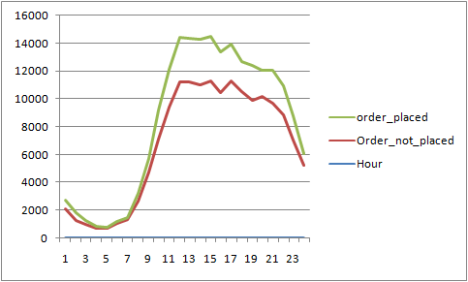
Inferences
What are the key differentiating sequences/subsequences/clicks between People ordered and Not ordered?
Timestamp: There’s high possibility of users placing orders between 11 AM and 2 PM and moderate possibility is between 9 AM and 11 PM
Funnel_level: Funnel level with lower and middle level have highest probability and upper level with lowest probability of placing orders.
Notes:
GRP: grp1494648619008, grp1022202216449 are the only two groups that differentiates people to place order from dropping off.
link635655159824, link300647710738, link549755813892, link755914244102, link1443109011458, link1554778161181, link575525617676, link979252543516

Slide 8
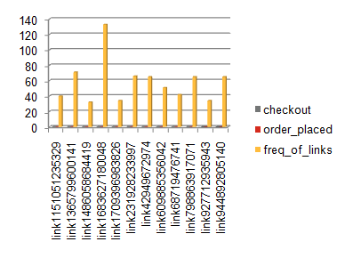
Inferences
2. What links or sequence of link lead to drop out after Adding to Cart and Checkout & where they drop out? (Checkout = 1 and order placed= 0)
link635655159824, link300647710738 - These links or combination of links, that lead to drop out (without placing the order) after adding to Cart and Checkout.
Notes:
GRP: grp1494648619008, grp1022202216449 are the only two groups that differentiates people to place order from dropping off.
link635655159824, link300647710738, link549755813892, link755914244102, link1443109011458, link1554778161181, link575525617676, link979252543516

Slide 9
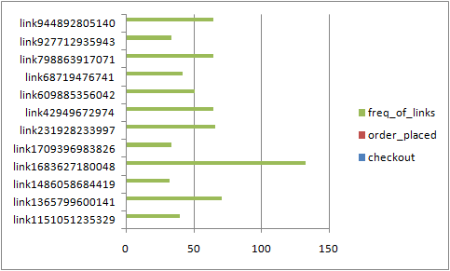
Inferences
3. What links or sequence of link factors lead to customers not checking out at all (which is (Checkout = 0 and order placed= 0)
link1683627180048, link1365799600141, link231928233997 are the top links or sequence of link factors that lead customers to never check out.

Slide 10
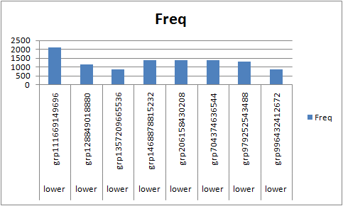
Inferences
4. How users in upper and Middle pushed into Lower, where will the intervention strategy for Middle and lower bucket happen for finishing order.
Users belonging to the group - grp111669149696 and its corresponding sequence of clicks, are pushed into Lower funnel level

Slide 11
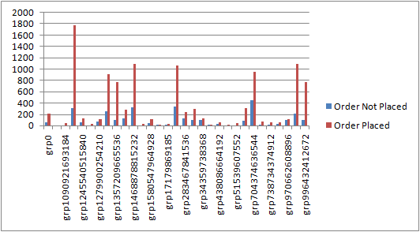
Additional Inference
Analysis on Order Placed > ~ Order Placed
Grp | Order Placed | ~ Order placed
grp1340029796352 | 8652 | 84432
grp111669149696 | 315 | 1779
grp1511828488192 | 6883 | 3273

